Slide 1
DevOps
Chef Activity

Slide 2
Convergent Configuration Management Using Chef

Slide 3
Setting Up Chef server
To load your chef platform extension, access Jenkins once your DevOps Academy stack is up and running through the public IP in the stack outputs: http://<public-IP>/jenkins
Go into the Platform Management folder and access the Load_Platform_Extension job:
http://<publicIP>/jenkins/job/Platform_Management
/job/Load_Platform_Extension/
Click on "Build with parameters"
Enter the following URL in the GIT_URL parameter:
https://github.com/Accenture/adop-platform-extension-chef
Leave the GIT_REF as the default value (master)

Slide 4
Setting Up Chef server
For the AWS_CREDENTIALS parameter, use the Add dropdown box to enter a new username and password credential set
For Username, enter the Access Key ID given which you entered during the DevOps Academy stack creation
For Password, enter the Secret Access Key which you were given
In case it is already in the list, select it
Click on the “Build” button
The chef server takes approximately 30 minutes to load
New stack will get created for this activity

Slide 5
Login To Chef Server
Click on the console output of your build of the Load_Platform_Extension job
You will be given a URL (in the form https://EC2-Service-Extension-1.<public-IP>.xip.io) at the bottom once the build has succeeded
If you get an error, use Chrome as a browser and choose to ignore the expired SSL certificate
The credentials to access your chef server through the user interface are as follows:
Username: admin
Password: admin@1

Slide 6
Security Pre-requisites
Before we load the chef pipeline we have to setup credentials to allow jenkins to interact with chef server. Jenkins needs two private keys -
Admin Key : This is to allow jenkins to interact with chef server and perform action like uploading cookbooks etc.
Chef Validator Key : This is to allow jenkins to bootstrap a node (server) against chef server.
We have to reset both the keys and add them as credentials to jenkins so that they are available for chef pipeline

Slide 7
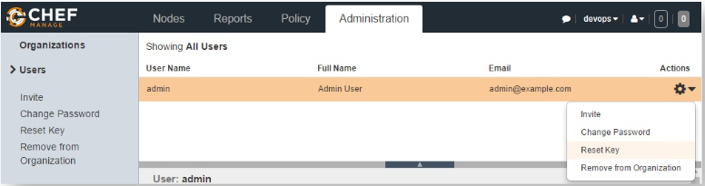
Reset Admin Key
Open a browser and go to
https://EC2-Service-Extension-1.<public-IP>
.xip.io/organizations/devops/users/admin
Reset the private key for admin user
Copy the private key in the block and click on the "Download" button
Include the header and footer sections, and save it as "admin.pem"

Slide 8
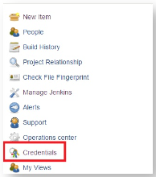
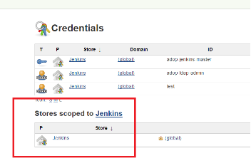
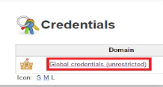
Add Admin Key To Jenkins
Open a browser and got to at http://<public IP>/jenkins
Click on "Credentials" link
Navigate to the "Jenkins" scope
Then navigate to "Global Credentials" -> "Add Credentials "

Slide 9
Add Admin Key To Jenkins
Select Kind as "SSH Username with private key "
Leave the Scope as it is
Username should be admin
For the "Private Key" select the "Enter directly" and in the text box you need to add the private key which we copied in the "Reset Admin Key" section.
Leave the passphrase as blank.
Description should be "chef admin user“
Click “OK”

Slide 10
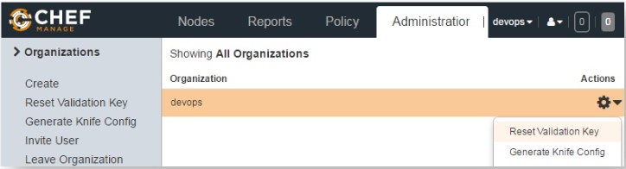
Reset Chef Validator Key
Go to your chef server and click on the Administration -> Organizations -> devops
Reset the validation key
Copy the private key in the block
Click on the "Download" button
Include the header and footer and save it as "devops-validator.pem"

Slide 11
Add Chef Validator Key To Jenkins
Open a browser and got to at http://<public IP>/jenkins
Click on "Credentials" link
Navigate to the "Jenkins" scope
Then navigate to "Global Credentials" -> "Add Credentials "
Select Kind as "SSH Username with private key "
Leave the Scope as it is
Username should be devops-validator

Slide 12
Add Chef Validator Key To Jenkins
For the "Private Key" select the "Enter directly" and in the text box you need to add the private key which we copied in the "Reset Chef Validator Key" section.
Leave the passphrase as blank.
Description should be "chef validator"
Click “OK”

Slide 13
Loading Chef CI Pipeline
Navigate to the DOA/job/Labs/job/Module5_Chef/ job/Generate_Chef_Pipeline_Jobs/
Click "Build with parameters“
Enter following parameters -
CHEF_SERVER_ORGANIZATION_URL :
https://EC2-Service-Extension-1.<public-IP>
.xip.io/organizations/devops
CHEF_SERVER_USERNAME : Select the credential for admin user which we added in last section
CHEF_SERVER_VALIDATOR : Select the credential for devops-validator user which we added in last section
Click "Build". Once the job is finished, it will generate Jenkins jobs and the pipeline view for chef CI

Slide 14
Configuring Workstation
Clone "adop-cartridge-chef-reference-cookbook" from Gerrit
git clone http://<public-IP>/gerrit/DOA/Labs/Module5
_Chef/adop-cartridge-chef-reference-cookbook
Provide the userId / password you created with stack
Make a change to a file in the adop-cartridge-chef-reference-cookbook
Create a directory ".chef“ in cloned repository
cd /c/Data/DevOpsAcademy/adop-cartridge-chef-reference-cookbook
mkdir .chef
Create a knife.rb file inside .chef directory

Slide 15
Configuring Workstation
Copy the following configuration
Update the <chef_server_url> with your chef server url
(for example - https://EC2-Service-Extension-1.<public-IP>.xip.io/organizations/devops)
me(__FILE__)
home = ENV['HOME']
user = ENV['OPSCODE_USER'] || 'admin'
org = ENV['ORGNAME'] || 'devops'
node_name user
client_key "#{user}.pem"
validation_client_name "#{org}-validator"
validation_key "#{org}-validator.pem"
chef_server_url "https://<chef_server_url>/organizations/#{org}"
syntax_check_cache_path "syntax_check_cache"
ssl_verify_mode :verify_none
cookbook_copyright 'Accenture'
cookbook_license ''
cookbook_email 'youremail@accenture.com'

Slide 16
Configuring Workstation
Copy the admin.pem and devops-validator.pem files downloaded earlier in this exercise to .chef directory
This completes the chef setup on your workstation
Push changes made
cd adop-cartridge-chef-reference-cookbook
git add .
git commit -m "Added knife configuration"
git push origin master
This automatically trigger the Get_Cookbooks job in Jenkins
Access the cookbooks available on your chef server
https://EC2-Service-Extension-1.<public-IP>.xip.io/organizations/devops/cookbooks

